Slide 1
Summer Term VA Certification

Slide 2
DISCLAIMER
The following presentation was created by the Oregon State University Veterans & Military Certifying Team.
The purpose of this presentation is to provide guidance on what to expect when using VA benefits during summer term. The VA always makes the final assessment of benefit payments and enrollment calculations.
We encourage you to reach out to us with questions or concerns about your specific situation.

Slide 3
What makes Summer term different?
Summer term has SIX sessions (aka mini-terms)
Your enrollment in each mini-term is certified separately
Enrolling in a total of 12 credits does not mean you are enrolled full-time for the summer term (for VA benefits)
Registration for all summer terms opens April 14
Summer Term Sessions | Standard or Non-standard | Session Dates
Session 1 | Standard length | June 23 – Sept 5
Session 2 | Non-standard length | Jun 23 – Jul 18
Session 3 | Non-standard length | Jun 23 – Aug 15
Session 4 | Non-standard length | Jul 21 – Aug 15
Session 5 | Non-standard length | Aug 18 – Sept 5
Session 6 | Non-standard length | Jun 16 – Jun 20

Slide 4
Undergraduate Mini-Term Enrollment
Summer Term Sessions | Standard or Non-standard | Full-Time Credits
Session 1 | 11-week standard length term | 12
Session 2 | 4-week non-standard length | 4
Session 3 | 8-week non-standard length | 8
Session 4 | 4-week non-standard length | 4
Session 5 | 3-week non-standard length | 3
Session 6 | 1-week non-standard length | 1
The number of credits that is considered full-time depends on the length of the session.
Quick Trick!
Number of weeks in the mini-term is equal to the number of credits that are considered full-time for that mini-term (for undergraduates)!

Slide 5
Graduate Mini-Term Enrollment
Summer Term Sessions | Standard or Non-standard | Full-Time Credits
Session 1 | 11-week standard length term | 9
Session 2 | 4-week non-standard length | 3
Session 3 | 8-week non-standard length | 6
Session 4 | 4-week non-standard length | 3
Session 5 | 3-week non-standard length | 3
Session 6 | 1-week non-standard length | 1
The number of credits that is considered full-time depends on the length of the session.

Slide 6
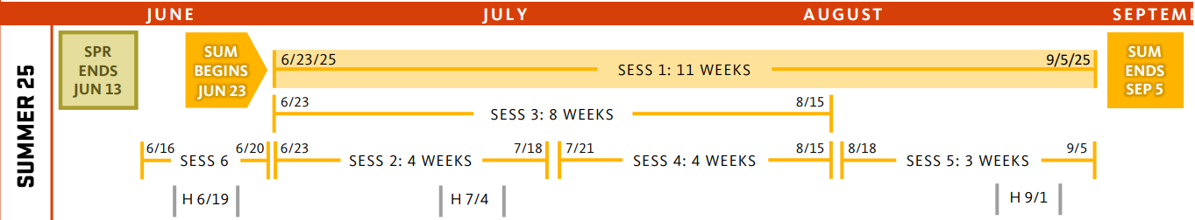
Overlapping Session & VA Enrollment Levels
When the dates of two sessions overlap, the enrollment level from both sessions may be counted towards full-time enrollment by the VA.
When one session starts or ends, your enrollment level may change and your benefits may increase, decrease, or stop.
For example, if you are registered in 8 credits during Session 3, you would be considered full-time from June 23-August 15. You would not be considered enrolled after August 15 and your benefits would stop.

Slide 7
Overlapping Sessions
It is important you add up your enrollment levels (and not credits!) when taking courses in sessions that overlap.
The VA will only combine your enrollment levels when the dates of two or more sessions overlap.
Session 1 ( STANDARD 11 WEEKS )
12 CR = Full
9-11 CR = ¾
6-8 CR = ½
4-5 CR = <½
1-3 CR = ¼
12 UG CREDITS = FULL-TIME
Session 2 (4 WEEKS) Session 4 (4 WEEKS) Session 5 (3 WEEKS)
4 CR = Full
3 CR = ¾
2 CR = ½
1 CR = ¼
4 CR = Full
3 CR = ¾
2 CR = ½
1 CR = ¼
3 CR = Full
2 CR = ½
1 CR = <½
Session 3 (8 WEEKS)
8 CR = Full
6-7 CR = ¾
4-5 CR = ½
3 CR = <½
1-2 CR = ¼
UNDERGRADUATE ENROLLMENT LEVELS

Slide 8

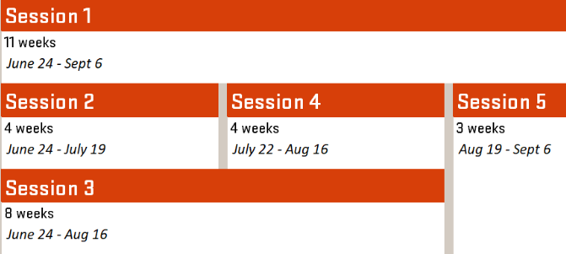
Pop Quiz
Combined enrollment levels during overlap only!
Benny Beaver is an undergraduate student enrolled in 9 credits in Session 1 (standard term) and 3 credits in Session 2 (4-week term).
How will the VA calculate Benny’s benefits?
Answer: Benny Beaver is enrolled ¾ time in Session 1 and ¾ time in Session 2. Benny will receive the full monthly housing allowance for the first four weeks when enrolled in Session 1 and Session 2.
Once Session 2 ends, Benny will receive a monthly housing allowance based on ¾ time enrollment in Session 1 only.
Extra-Credit
Benny is enrolled in online classes during Session 1 and an on-campus course in Session 2.
What housing rate will Benny receive under Post 9/11®?
Answer:
Benny’s housing will be based on the campus location during Session 2. Once Session 2 ends, Benny’s housing will be based on ½ the National Average (aka online rate).
Benny’s 9 credit classes
Benny’s 3 credit class
GI Bill® is a registered trademark of the U.S. Department of Veterans Affairs (VA). More information about education benefits offered by VA is available at the official U.S. government Web site at https://www.benefits.va.gov/gibill.

Slide 9
Gaps and Housing Allowance
Gaps are the days between the end of one mini-term and the start of the next mini-term. The VA will not pay benefits during any time period that classes are not in session; this means that these gaps will affect your housing allowance.
For Example, Session 2 and Session 5 have a one-month gap between them. Session 2 and Session 4 have a two-day gap between them.
Keep in mind that the VA will not charge your monthly entitlement when you are not enrolled in classes.

Slide 10
Summer Payment Differences
Summer housing or monthly stipend payments are not always paid in one monthly payment each month. The disbursement may include multiple checks of smaller amounts.
The tuition and fees for your enrollment in summer term will be certified according to the corresponding session. This means that you may receive more than one tuition payment from the VA if you are enrolled in more than one session.
We continue to wait until after the add/drop period is over before certifying tuition and fees. If you are enrolled in sessions 4 or 5, you may have a balance on your account until the add/drop period for those sessions has ended. Any interest or fees that may have been charged to your OSU student account will be removed once the payment from the VA arrives.

Slide 11
Advance of VA Funds
OSU does not automatically advance VA (Chapter 33) funds to your OSU student account for summer term.
If you need to request an advance of VA funds to access your financial aid, please email veterans@oregonstate.edu

Slide 12
Don’t Forget About Deadlines!
Deadlines for summer mini-terms are often much shorter than the deadlines for the rest of the year.
Session dates, deadlines, and tuition refund schedule information are displayed in the academic calendar.
Please keep in mind that shorter length sessions are accelerated classes. Please reach out to your academic advisor with questions about your summer term schedule.

Slide 13
Veterans and Military Certifying Team
Email: veterans@oregonstate.edu
Phone: 541-737-0747
Office: B102 Kerr Administration Building
Website: registrar.oregonstate.edu/veterans

